Slide 1
Chapter 19: Recovery System

Slide 2
Outline
Failure Classification
Storage Structure
Recovery and Atomicity
Log-Based Recovery
Remote Backup Systems

Slide 3
Failure Classification
Transaction failure :
Logical errors: transaction cannot complete due to some internal error condition
System errors: the database system must terminate an active transaction due to an error condition (e.g., deadlock)
System crash: a power failure or other hardware or software failure causes the system to crash.
Fail-stop assumption: non-volatile storage contents are assumed to not be corrupted by system crash
Database systems have numerous integrity checks to prevent corruption of disk data
Disk failure: a head crash or similar disk failure destroys all or part of disk storage
Destruction is assumed to be detectable: disk drives use checksums to detect failures
Notes:
An integral part of a database system is a recovery scheme that can restore the database to the consistent state that existed before the failure.
The recovery scheme must also support high availability, that is, the database should be usable for a very high percentage of time. To support high availability in the face of machine failure (as also planned machine shutdowns for hardware/software upgrades and maintenance), the recovery scheme must support the ability to keep a backup copy of the database synchronized with the current contents of the primary copy of the database. If the machine with the primary copy fails, transaction processing can continue on the backup copy.
There are various types of failure that may occur in a system, each of which needs to be dealt with in a different manner. In this chapter, we shall consider only the following types of failure:
• Transaction failure. There are two types of errors that may cause a transaction to fail:
° Logical error. The transaction can no longer continue with its normal execution because of some internal condition, such as bad input, data not found, overflow, or resource limit exceeded.
° System error. The system has entered an undesirable state (e.g., deadlock), as a result of which a transaction cannot continue with its normal execution. The transaction, however, can be reexecuted at a later time.
• System crash. There is a hardware malfunction, or a bug in the database software or the operating system, that causes the loss of the content of volatile storage and brings transaction processing to a halt. The content of non-volatile storage remains intact and is not corrupted.
The assumption that hardware errors and bugs in the software bring the system to a halt, but do not corrupt the non-volatile storage contents, is known as the fail-stop assumption. Well-designed systems have numerous internal checks, at the hardware and the software level, that bring the system to a halt when there is an error. Hence, the fail-stop assumption is a reasonable one.
• Disk failure. A disk block loses its content as a result of either a head crash or failure during a data-transfer operation. Copies of the data on other disks, or archival backups on tertiary media, such as DVD or tapes, are used to recover from the failure.

Slide 4
Recovery Algorithms
Suppose transaction T_{i} transfers $50 from account A to account B
Two updates: subtract 50 from A and add 50 to B
Transaction T_{i} requires updates to A and B to be output to the database.
A failure may occur after one of these modifications have been made but before both of them are made.
Modifying the database without ensuring that the transaction will commit may leave the database in an inconsistent state
Not modifying the database may result in lost updates if failure occurs just after transaction commits
Recovery algorithms have two parts
Actions taken during normal transaction processing to ensure enough information exists to recover from failures
Actions taken after a failure to recover the database contents to a state that ensures atomicity, consistency and durability
Notes:
To determine how the system should recover from failures, we need to identify the failure modes of those devices used for storing data. Next, we must consider how these failure modes affect the contents of the database. We can then propose algorithms to ensure database consistency and transaction atomicity despite failures. These algorithms, known as recovery algorithms, have two parts:
Actions taken during normal transaction processing to ensure that enough information exists to allow recovery from failures.
Actions taken after a failure to recover the database contents to a state that ensures database consistency, transaction atomicity, and durability

Slide 5
Storage Structure
Volatile storage:
Does not survive system crashes
Examples: main memory, cache memory
Nonvolatile storage:
Survives system crashes
Examples: disk, tape, flash memory, non-volatile RAM
But may still fail, losing data
Stable storage:
A mythical form of storage that survives all failures
Approximated by maintaining multiple copies on distinct nonvolatile media
See book for more details on how to implement stable storage
Notes:
As we saw in Chapter 13, the various data items in the database may be stored and accessed in a number of different storage media.
• Volatile storage. Information residing in volatile storage does not usually survive system crashes. Examples of such storage are main memory and cache memory. Access to volatile storage is extremely fast, both because of the speed of the memory access itself and because it is possible to access any data item in volatile storage directly.
• Non-volatile storage. Information residing in non-volatile storage survives system crashes. Examples of non-volatile storage include secondary storage devices such as magnetic disk and flash storage, used for online storage, and tertiary storage devices such as optical media and magnetic tapes, used for archival storage. At the current state of technology, non-volatile storage is slower than volatile storage, particularly for random access. Both secondary and tertiary storage devices, however, are susceptible to failures that may result in loss of information.
• Stable storage. Information residing in stable storage is never lost (never should be taken with a grain of salt, since theoretically never cannot be guaranteed—for example, it is possible, although extremely unlikely, that a black hole may envelop the earth and permanently destroy all data!). Although stable storage is theoretically impossible to obtain, it can be closely approximated by techniques that make data loss extremely unlikely. To implement stable storage, we replicate the information in several non-volatile storage media (usually disk) with independent failure modes. Updates must be done with care to ensure that a failure during an update to stable storage does not cause a loss of information. Section 19.2.1 discusses stable-storage implementation.

Slide 6
Stable-Storage Implementation
Maintain multiple copies of each block on separate disks
copies can be at remote sites to protect against disasters such as fire or flooding.
Failure during data transfer can still result in inconsistent copies: Block transfer can result in
Successful completion
Partial failure: destination block has incorrect information
Total failure: destination block was never updated
Protecting storage media from failure during data transfer (one solution):
Execute output operation as follows (assuming two copies of each block):
Write the information onto the first physical block.
When the first write successfully completes, write the same information onto the second physical block.
The output is completed only after the second write successfully completes.
Notes:
6
To implement stable storage, we need to replicate the needed information in several non-volatile storage media (usually disk) with independent failure modes and to update the information in a controlled manner to ensure that failure during data transfer does not damage the needed information.
Recall (from Chapter 12) that RAID systems guarantee that the failure of a single disk (even during data transfer) will not result in loss of data. The simplest and fastest form of RAID is the mirrored disk, which keeps two copies of each block on separate disks. Other forms of RAID offer lower costs, but at the expense of lower performance.
RAID systems, however, cannot guard against data loss due to disasters such as fires or flooding. Many systems store archival backups of tapes off-site to guard against such disasters. However, since tapes cannot be carried off-site continually, updates since the most recent time that tapes were carried off-site could be lost in such a disaster. More secure systems keep a copy of each block of stable storage at a remote site, writing it out over a computer network, in addition to storing the block on a local disk system. Since the blocks are output to a remote system as and when they are output to local storage, once an output operation is complete, the output is not lost, even in the event of a disaster such as a fire or flood. We study such remote backup systems in Section 19.7.
In the remainder of this section, we discuss how storage media can be protected from failure during data transfer. Block transfer between memory and disk storage can result in:
• Successful completion. The transferred information arrived safely at its destination.
• Partial failure. A failure occurred in the midst of transfer, and the destination block has incorrect information.
• Total failure. The failure occurred sufficiently early during the transfer that the destination block remains intact.
We require that, if a data-transfer failure occurs, the system detects it and invokes a recovery procedure to restore the block to a consistent state. To do so, the system must maintain two physical blocks for each logical database block; in the case of mirrored disks, both blocks are at the same location; in the case of remote backup, one of the blocks is local, whereas the other is at a remote site. An output operation is executed as follows:
Write the information onto the first physical block.
When the first write completes successfully, write the same information onto the second physical block.
The output is completed only after the second write completes successfully

Slide 7
Protecting storage media from failure (Cont.)
Copies of a block may differ due to failure during output operation.
To recover from failure:
1. First find inconsistent blocks:
Expensive solution: Compare the two copies of every disk block.
Better solution:
Record in-progress disk writes on non-volatile storage (Flash, Non-volatile RAM or special area of disk).
Use this information during recovery to find blocks that may be inconsistent, and only compare copies of these.
Used in hardware RAID systems
2. If either copy of an inconsistent block is detected to have an error
(bad checksum), overwrite it by the other copy. If both have no error,
but are different, overwrite the second block by the first block.
Notes:
7
If the system fails while blocks are being written, it is possible that the two copies of a block could be inconsistent with each other.
During recovery, for each block, the system would need to examine two copies of the blocks. If both are the same and no detectable error exists, then no further actions are necessary. (Recall that errors in a disk block, such as a partial write to the block, are detected by storing a checksum with each block.) If the system detects an error in one block, then it replaces its content with the content of the other block.
If both blocks contain no detectable error, but they differ in content, then the system can either replace the content of the first block with the value of the second, or replace the content of the second block with the value of the first. Either way, the recovery procedure ensures that a write to stable storage either succeeds completely (i.e., updates all copies) or results in no change.
The requirement of comparing every corresponding pair of blocks during recovery is expensive to meet. We can reduce the cost greatly by keeping track of block writes that are in progress, using a small amount of non-volatile RAM. On recovery, only blocks for which writes were in progress need to be compared.
The protocols for writing out a block to a remote site are similar to the protocols for writing blocks to a mirrored disk system, which we examined in Chapter 12, and particularly in Practice Exercise 12.6.

Slide 8
Data Access
Physical blocks are those blocks residing on the disk.
Buffer blocks are the blocks residing temporarily in main memory.
Block movements between disk and main memory are initiated through the following two operations:
input (B) transfers the physical block B to main memory.
output (B) transfers the buffer block B to the disk, and replaces the appropriate physical block there.
We assume, for simplicity, that each data item fits in, and is stored inside, a single block.
Notes:
As we saw in Chapter 12, the database system resides permanently on non-volatile storage (usually disks), and only parts of the database are in memory at any time. (In main-memory databases, the entire database resides in memory, but a copy still resides on non-volatile storage so data can survive the loss of main-memory contents.) The database is partitioned into fixed-length storage units called blocks. Blocks are the units of data transfer to and from disk and may contain several data items.
Transactions input information from the disk into main memory and then output the information back onto the disk. The input and output operations are done in block units. The blocks residing on the disk are referred to as physical blocks; the blocks residing temporarily in main memory are referred to as buffer blocks. The area of memory where blocks reside temporarily is called the disk buffer.
Block movements between disk and main memory are initiated through the following two operations:
input(B) transfers the physical block B to main memory.
output(B) transfers the buffer block B to the disk and replaces the appropriate physical block there.

Slide 9
Data Access (Cont.)
Each transaction T_{i} has its private work-area in which local copies of all data items accessed and updated by it are kept.
T_{i} 's local copy of a data item X is called x_{i}.
Transferring data items between system buffer blocks and its private work-area done by:
read(X) assigns the value of data item X to the local variable x_{i}.
write(X) assigns the value of local variable x_{i} to data item {X} in the buffer block.
Note: output(B_{X}) need not immediately follow write(X). System can perform the output operation when it deems fit.
Transactions
Must perform read(X) before accessing X for the first time (subsequent reads can be from local copy)
write(X) can be executed at any time before the transaction commits
Notes:
Conceptually, each transaction Ti has a private work area in which copies of data items accessed and updated by Ti are kept. The system creates this work area when the transaction is initiated; the system removes it when the transaction either commits or aborts. Each data item X kept in the work area of transaction Ti is denoted by xi . Transaction Ti interacts with the database system by transferring data to and from its work area to the system buffer. We transfer data by these two operations:
read(X) assigns the value of data item X to the local variable xi . It executes this operation as follows:
If block BX on which X resides is not in main memory, it issues input(BX ).
It assigns to xi the value of X from the buffer block.
write(X) assigns the value of local variable xi to data item X in the buffer block. It executes this operation as follows:
If block BX on which X resides is not in main memory, it issues input(BX ).
It assigns the value of xi to X in buffer BX .
When a transaction needs to access a data item X for the first time, it must execute read(X). The transaction then performs all updates to X on xi . At any point during its execution a transaction may execute write(X) to reflect the change to X in the database itself; write(X) must certainly be done after the final write to xi .

Slide 10
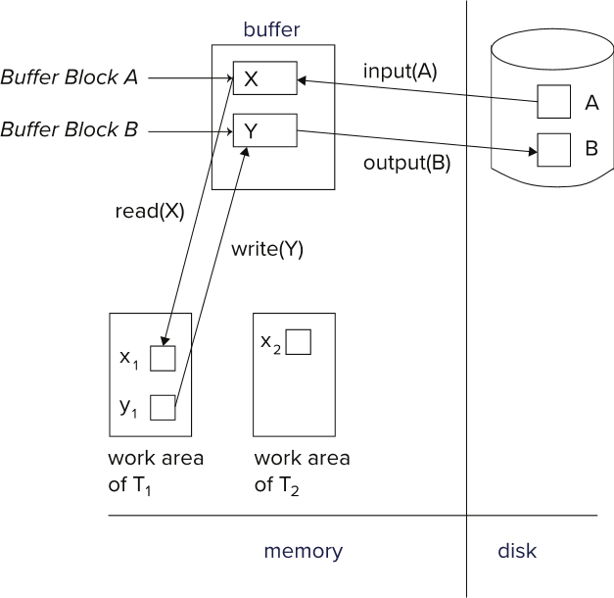
Example of Data Access

Slide 11
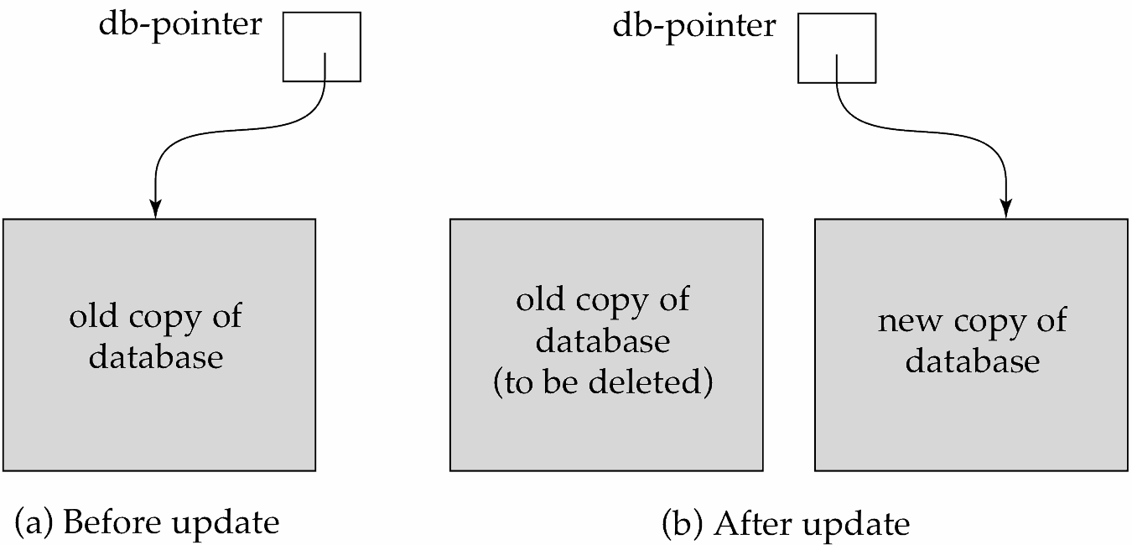
Recovery and Atomicity
To ensure atomicity despite failures, we first output information describing the modifications to stable storage without modifying the database itself.
We study log-based recovery mechanisms in detail
We first present key concepts
And then present the actual recovery algorithm
Less used alternative: shadow-copy and shadow-paging (brief details in book)
shadow-copy
Notes:
To achieve our goal of atomicity, we must first output to stable storage information describing the modifications, without modifying the database itself. As we shall see, this information can help us ensure that all modifications performed by committed transactions are reflected in the database (perhaps during the course of recovery actions after a crash).
We also need to store information about the old value of any item updated by a modification in case the transaction performing the modification fails (aborts). This information can help us undo the modifications made by the failed transaction.
The most commonly used technique for recovery is based on log records, and we study log-based recovery in detail in this chapter. An alternative, called shadow copying, is used by text editors but is not used in database systems;

Slide 12
Log-Based Recovery
A log is a sequence of log records. The records keep information about update activities on the database.
The log is kept on stable storage
When transaction T_{i} starts, it registers itself by writing a
<T_{i} start> log record
Before T_{i} executes write(X), a log record
<T_{i}, X, V₁, V₂>
is written, where V₁ is the value of X before the write (the old
value), and V₂ is the value to be written to X (the new value).
When T_{i} finishes it last statement, the log record <T_{i} commit> is written.
Two approaches using logs
Immediate database modification
Deferred database modification.
Notes:
The most widely used structure for recording database modifications is the log.
The log is a sequence of log records, recording all the update activities in the database. There are several types of log records. An update log record describes a single database write. It has these fields:
• Transaction identifier, which is the unique identifier of the transaction that performed the write operation.
• Data-item identifier, which is the unique identifier of the data item written. Typically, it is the location on disk of the data item, consisting of the block identifier of the block on which the data item resides and an offset within the block.
• Old value, which is the value of the data item prior to the write.
• New value, which is the value that the data item will have after the write.
We represent an update log record as , indicating that transaction Ti has performed a write on data item Xj . Xj had value V1 before the write and has value V2 after the write. Other special log records exist to record significant events during transaction processing, such as the start of a transaction and the commit or abort of a transaction. Among the types of log records are:
• <Ti start>Transaction Ti has started.
• <Ti commit> Transaction Ti has committed.
• < Ti abort> Transaction Ti has aborted.

Slide 13
Immediate Database Modification
The immediate-modification scheme allows updates of an uncommitted transaction to be made to the buffer, or the disk itself, before the transaction commits
Update log record must be written before database item is written
We assume that the log record is output directly to stable storage
(Will see later that how to postpone log record output to some extent)
Output of updated blocks to disk can take place at any time before or after transaction commit
Order in which blocks are output can be different from the order in which they are written.
The deferred-modification scheme performs updates to buffer/disk only at the time of transaction commit
Simplifies some aspects of recovery
But has overhead of storing local copy
Notes:
If database modifications occur while the transaction is still active, the transaction is said to use the immediate modification technique. Deferred modification has the overhead that transactions need to make local copies of all updated data items; further, if a transaction reads a data item that it has updated, it must read the value from its local copy.
We say a transaction modifies the database if it performs an update on a disk buffer, or on the disk itself; updates to the private part of main memory do not count as database modifications. If a transaction does not modify the database until it has committed, it is said to use the deferred-modification technique.

Slide 14
Transaction Commit
A transaction is said to have committed when its commit log record is output to stable storage
All previous log records of the transaction must have been output already
Writes performed by a transaction may still be in the buffer when the transaction commits, and may be output later
Notes:
Because all database modifications must be preceded by the creation of a log record, the system has available both the old value prior to the modification of the data item and the new value that is to be written for the data item. This allows the system to perform undo and redo operations as appropriate.
• The undo operation using a log record sets the data item specified in the log record to the old value contained in the log record.
• The redo operation using a log record sets the data item specified in the log record to the new value contained in the log record.

Slide 15
Immediate Database Modification Example
Log Write Output
<T₀ start>
<T₀, A, 1000, 950>
<T₀, B, 2000, 2050>
A = 950
B = 2050
<T₀ commit>
<T₁ start>
<T₁, C, 700, 600>
C = 600
B_{B} , B_{C}
<T₁ commit>
B_{A}
Note: B_{X} denotes block containing X.
B_{C} output before T₁ commits
B_{A} output after T₀ commits

Slide 16
Concurrency Control and Recovery
With concurrent transactions, all transactions share a single disk buffer and a single log
A buffer block can have data items updated by one or more transactions
We assume that if a transaction T_{i} has modified an item, no other transaction can modify the same item until T_{i} has committed or aborted
i.e., the updates of uncommitted transactions should not be visible to other transactions
Otherwise, how to perform undo if T₁ updates A, then T₂ updates A and commits, and finally T₁ has to abort?
Can be ensured by obtaining exclusive locks on updated items and holding the locks till end of transaction (strict two-phase locking)
Log records of different transactions may be interspersed in the log.

Slide 17
Undo and Redo Operations
Undo and Redo of Transactions
undo(T_{i}) -- restores the value of all data items updated by T_{i} to their old values, going backwards from the last log record for T_{i}
Each time a data item X is restored to its old value V a special log record <T_{i} , X, V> is written out
When undo of a transaction is complete, a log record <T_{i} abort> is written out.
redo(T_{i}) -- sets the value of all data items updated by T_{i} to the new values, going forward from the first log record for T_{i}
No logging is done in this case
Notes:
Using the log, the system can handle any failure that does not result in the loss of information in non-volatile storage. The recovery scheme uses two recovery procedures. Both these procedures make use of the log to find the set of data items updated by each transaction Ti and their respective old and new values.
• redo(Ti ). The procedure sets the value of all data items updated by transaction Ti to the new values. The order in which updates are carried out by redo is important; when recovering from a system crash, if updates to a particular data item are applied in an order different from the order in which they were applied originally, the final state of that data item will have a wrong value. Most recovery algorithms, including the one we describe in Section 19.4, do not perform redo of each transaction separately; instead they perform a single scan of the log, during which redo actions are performed for each log record as it is encountered. This approach ensures the order of updates is preserved, and it is more efficient since the log needs to be read only once overall, instead of once per transaction.
• undo(Ti ). The procedure restores the value of all data items updated by transaction Ti to the old values. In the recovery scheme that we describe in Section 19.4:
° The undo operation not only restores the data items to their old value, but also writes log records to record the updates performed as part of the undo process. These log records are special redo-only log records, since they do not need to contain the old value of the updated data item; note that when such log records are used during undo, the “old value” is actually the value written by the transaction that is being rolled back, and the “new value” is the original value that is being restored by the undo operation.
° When the undo operation for transaction Ti completes, it writes a log record, indicating that the undo has completed.

Slide 18
Recovering from Failure
When recovering after failure:
Transaction T_{i} needs to be undone if the log
Contains the record <T_{i} start>,
But does not contain either the record <T_{i} commit> or <T_{i} abort>.
Transaction T_{i} needs to be redone if the log
Contains the records <T_{i} start>
And contains the record <T_{i} commit> or <T_{i} abort>
Notes:
After a system crash has occurred, the system consults the log to determine which transactions need to be redone and which need to be undone so as to ensure atomicity.
• Transaction Ti needs to be undone if the log contains the record but does not contain either the record or the record .
• Transaction Ti needs to be redone if the log contains the record and either the record or the record . It may seem strange to redo Ti if the record is in the log. To see why this works, note that if is in the log, so are the redo-only records written by the undo operation. Thus, the end result will be to undo Ti ’s modifications in this case. This slight redundancy simplifies the recovery algorithm and enables faster overall recovery time.

Slide 19
Recovering from Failure (Cont.)
Suppose that transaction T_{i} was undone earlier and the <T_{i} abort> record was written to the log, and then a failure occurs,
On recovery from failure transaction T_{i} is redone
Such a redo redoes all the original actions of transaction T_{i} including the steps that restored old values
Known as repeating history
Seems wasteful, but simplifies recovery greatly
Notes:
SLAJD
As an illustration, return to our banking example, with transaction T0 and T1 executed one after the other in the order T0 followed by T1. Suppose that the system crashes before the completion of the transactions. We shall consider three cases. The state of the logs for each of these cases appears in Figure 19.4.

Slide 20
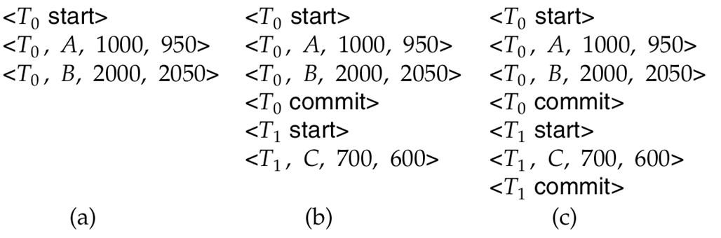
Immediate DB Modification Recovery Example
Below we show the log as it appears at three instances of time.
Recovery actions in each case above are:
(a) undo (T₀): B is restored to 2000 and A to 1000, and log records <T₀, B, 2000>, <T₀, A, 1000>, <T₀, abort> are written out
(b) redo (T₀) and undo (T₁): A and B are set to 950 and 2050 and C is restored to 700. Log records <T₁, C, 700>, <T₁, abort> are written out.
(c) redo (T₀) and redo (T₁): A and B are set to 950 and 2050
respectively. Then C is set to 600

Slide 21
Checkpoints
Redoing/undoing all transactions recorded in the log can be very slow
Processing the entire log is time-consuming if the system has run for a long time
We might unnecessarily redo transactions which have already output their updates to the database.
Streamline recovery procedure by periodically performing checkpointing
1. Output all log records currently residing in main memory onto stable
storage.
2. Output all modified buffer blocks to the disk.
3. Write a log record < checkpoint L> onto stable storage where L is a
list of all transactions active at the time of checkpoint.
4. All updates are stopped while doing checkpointing
Notes:
When a system crash occurs, we must consult the log to determine those transactions that need to be redone and those that need to be undone. In principle, we need to search the entire log to determine this information. There are two major difficulties with this approach:
The search process is time-consuming.
Most of the transactions that, according to our algorithm, need to be redone have already written their updates into the database. Although redoing them will cause no harm, it will nevertheless cause recovery to take longer.
To reduce these types of overhead, we introduce checkpoints.
We discuss later how to modify the checkpointing and recovery procedures to provide more flexibility by relaxing both these requirements. A checkpoint is performed as follows:
Output onto stable storage all log records currently residing in main memory.
Output to the disk all modified buffer blocks.
Output onto stable storage a log record of the form , where L is a list of transactions active at the time of the checkpoint.

Slide 22
Checkpoints (Cont.)
During recovery we need to consider only the most recent transaction T_{i} that started before the checkpoint, and transactions that started after T_{i}.
Scan backwards from end of log to find the most recent <checkpoint L> record
Only transactions that are in L or started after the checkpoint need to be redone or undone
Transactions that committed or aborted before the checkpoint already have all their updates output to stable storage.
Some earlier part of the log may be needed for undo operations
Continue scanning backwards till a record <T_{i} start> is found for every transaction T_{i} in L.
Parts of log prior to earliest <T_{i} start> record above are not needed for recovery, and can be erased whenever desired.

Slide 23
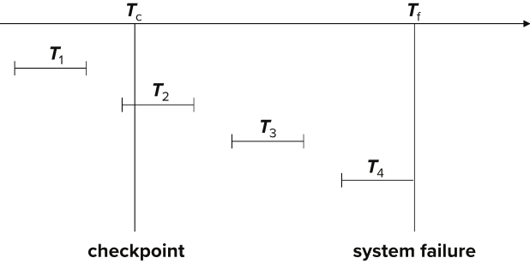
Example of Checkpoints
T₁ can be ignored (updates already output to disk due to checkpoint)
T₂ and T₃ redone.
T₄ undone
T₁ can be ignored (updates already output to disk due to checkpoint)
T₂ and T₃ redone.
T₄ undone

Slide 24
Remote Backup Systems

Slide 25
Remote Backup Systems
Remote backup systems provide high availability by allowing transaction processing to continue even if the primary site is destroyed.
Notes:
Traditional transaction-processing systems are centralized or client–server systems. Such systems are vulnerable to environmental disasters such as fire, flooding, or earthquakes. Today’s applications need transaction-processing systems that can function in spite of system failures or environmental disasters.
Such systems must provide high availability; that is, the time for which the system is unusable must be extremely short. We can achieve high availability by performing transaction processing at one site, called the primary site, and having a remote backup site where all the data from the primary site are replicated. The remote backup site is sometimes also called the secondary site.
The remote site must be kept synchronized with the primary site as updates are performed at the primary. We achieve synchronization by sending all log records from the primary site to the remote backup site. The remote backup site must be physically separated from the primary—for example, we can locate it in a different state—so that a disaster such as a fire, flood or an earthquake at the primary does not also damage the remote backup site.3
Figure 19.6 shows the architecture of a remote backup system. When the primary site fails, the remote backup site takes over processing. First, however, it performs recovery, using its (perhaps outdated) copy of the data from the primary and the log records received from the primary. In effect, the remote backup site is performing recovery actions that would have been performed at the primary site when the latter recovered. Standard recovery algorithms, with minor modifications, can be used for recovery at the remote backup site. Once recovery has been performed, the remote backup site starts processing transactions.

Slide 26
Remote Backup Systems (Cont.)
Detection of failure: Backup site must detect when primary site has failed
to distinguish primary site failure from link failure maintain several communication links between the primary and the remote backup.
Heart-beat messages
Transfer of control:
To take over control backup site first perform recovery using its copy of the database and all the long records it has received from the primary.
Thus, completed transactions are redone and incomplete transactions are rolled back.
When the backup site takes over processing it becomes the new primary
To transfer control back to old primary when it recovers, old primary must receive redo logs from the old backup and apply all updates locally.
Notes:
Availability is greatly increased over a single-site system, since the system can recover even if all data at the primary site are lost. Several issues must be addressed in designing a remote backup system:
• Detection of failure. It is important for the remote backup system to detect when the primary has failed. Failure of communication lines can fool the remote backup into believing that the primary has failed. To avoid this problem, we maintain several communication links with independent modes of failure between the primary and the remote backup. For example, several independent network connections, including perhaps a modem connection over a telephone line, may be used. These connections may be backed up via manual intervention by operators, who can communicate over the telephone system.
• Transfer of control. When the primary fails, the backup site takes over processing and becomes the new primary. The decision to transfer control can be done manually or can be automated using software provided by database system vendors. Queries must now be sent to the new primary. To do so automatically, many systems assign the IP address of the old primary to the new primary. Existing database connections will fail, but when an application tries to reopen a connection it gets connected to the new primary. Some systems instead use a high availability proxy machine.
Application clients do not connect to the database directly, but connect through the proxy. The proxy transparently routes application requests to the current primary. (There can be more than one machine acting as proxy at the same time, to deal with a situation where a proxy machine fails; requests can be routed through any active proxy machine.)
When the original primary site recovers, it can either play the role of remote backup or it can take over the role of primary site again. In either case, the old primary must receive a log of updates carried out by the backup site while the old primary was down.
The old primary must catch up with the updates in the log by applying them locally. The old primary can then act as a remote backup site. If control must be transferred back, the new primary (which is the old backup site) can pretend to have failed, resulting in the old primary taking over.

Slide 27
Remote Backup Systems (Cont.)
Time to recover: To reduce delay in takeover, backup site periodically process the redo log records (in effect, performing recovery from previous database state), performs a checkpoint, and can then delete earlier parts of the log.
Hot-Spare configuration permits very fast takeover:
Backup continually processes redo log record as they arrive, applying the updates locally.
When failure of the primary is detected the backup rolls back incomplete transactions, and is ready to process new transactions.
Alternative to remote backup: distributed database with replicated data
Remote backup is faster and cheaper, but less tolerant to failure
more on this in Chapter 19
Notes:
• Time to recover. If the log at the remote backup grows large, recovery will take a long time. The remote backup site can periodically process the redo log records that it has received and can perform a checkpoint so that earlier parts of the log can be deleted. The delay before the remote backup takes over can be significantly reduced as a result.
A hot-spare configuration can make takeover by the backup site almost instantaneous. In this configuration, the remote backup site continually processes redo log records as they arrive, applying the updates locally. As soon as the failure of the primary is detected, the backup site completes recovery by rolling back incomplete transactions; it is then ready to process new transactions.

Slide 28
Remote Backup Systems (Cont.)
Ensure durability of updates by delaying transaction commit until update is logged at backup; avoid this delay by permitting lower degrees of durability.
One-safe: commit as soon as transaction’s commit log record is written at primary
Problem: updates may not arrive at backup before it takes over.
Two-very-safe: commit when transaction’s commit log record is written at primary and backup
Reduces availability since transactions cannot commit if either site fails.
Two-safe: proceed as in two-very-safe if both primary and backup are active. If only the primary is active, the transaction commits as soon as is commit log record is written at the primary.
Better availability than two-very-safe; avoids problem of lost transactions in one-safe.
Notes:
• Time to commit. To ensure that the updates of a committed transaction are durable, a transaction must not be declared committed until its log records have reached the backup site. This delay can result in a longer wait to commit a transaction, and some systems therefore permit lower degrees of durability.
The degrees of durability can be classified as follows:
° One-safe. A transaction commits as soon as its commit log record is written to stable storage at the primary site. The problem with this scheme is that the updates of a committed transaction may not have made it to the backup site when the backup site takes over processing. Thus, the updates may appear to be lost. When the primary site recovers, the lost updates cannot be merged in directly, since the updates may conflict with later updates performed at the backup site. Thus, human intervention may be required to bring the database to a consistent state.
° Two-very-safe. A transaction commits as soon as its commit log record is written to stable storage at the primary and the backup site. The problem with this scheme is that transaction processing cannot proceed if either the primary or the backup site is down. Thus, availability is actually less than in the single-site case, although the probability of data loss is much less.
° Two-safe. This scheme is the same as two-very-safe if both primary and backup sites are active. If only the primary is active, the transaction is allowed to commit as soon as its commit log record is written to stable storage at the primary site. This scheme provides better availability than does two-very-safe, while avoiding the problem of lost transactions faced by the one-safe scheme. It results in a slower commit than the one-safe scheme, but the benefits generally outweigh the cost.

